Slide 1
EXPLORING NIFTY 50 STOCK PRICES USING PYTHON
Overview:
Python-based analysis using pandas, matplotlib, numpy, scikit-learn, and seaborn.
Date range: 2008 to present.
Options for plotting, predicting, and analyzing stock prices.
Presented By Nandeesh H U - 234161018

Slide 2

Motivation Behind the Problem
1
Investment Decision Making:
2
6
Investment Decision Making:
Algorithmic Trading:
3
7
Risk Management:
Economic Indicators:
4
8
Strategic Planning:
Educational Purposes:
5
9
Market Insights:
Adaptability and Automation:

Slide 3
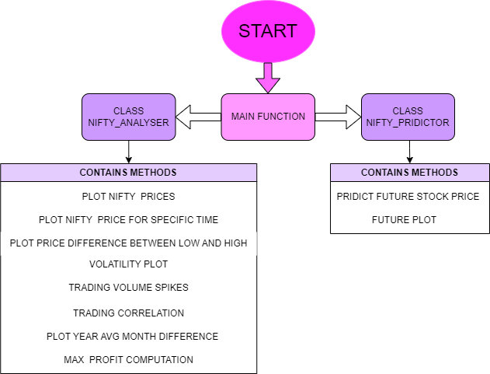
BLOCK DIAGRAM

Slide 4
GENERALIZED PSUEDOCODES VIEW
for col in cols_to_predict:
# Check and handle missing values in the current column
handle_missing_values(df, col)
# Prepare data for linear regression
X, y = prepare_data_for_regression(historical_dates, df[col])
# Fit linear regression model
model.fit(X, y)
# Predict the price at the target date
predicted_prices[col] = predict_price_at_target_date(model, target_date, historical_dates)
return predicted_prices
Step 5. Future Price Prediction Loop
predicted_prices = initialize_predicted_prices_dict()
current_date = start_date
while current_date <= end_date:
predictions = predict_stock_prices(current_date, model, df)
update_predicted_prices(predicted_prices, predictions)
current_date += timedelta(days=1)
Step 6. Plotting Function
plot_predicted_prices(predicted_prices, start_date, end_date)
#Step1. Data Retrieval
try:
df = retrieve_data()
except WebDataError:
df = retrieve_data_from_csv()
Step 2. Data Preprocessing
df = preprocess_data(df)
Step 3. Linear Regression Model Initialization
model = initialize_linear_regression_model()
Step 4. Stock Price Prediction Function
def predict_stock_prices(target_date, model, df):
# Ensure 'Date' column is in datetime format
df['Date'] = convert_to_datetime(df['Date'])
# Sort the DataFrame by date
df = sort_data_by_date(df)
# Extract historical dates and prices
historical_dates = get_historical_dates(df)
cols_to_predict = get_columns_to_predict()
predicted_prices = {}

Slide 5

WEBSCRAPPING
Leveraging Pandas for web scraping simplifies data retrieval and management, providing a robust solution for both online and offline scenarios.
Pythonic Features
1
DATE MANIPULATION
Using Pandas to ensure datetime consistency enhances code readability and simplifies subsequent date-related operations.
2
DYNAMIC PLOTTING
Matplotlib's dynamic plotting capabilities combined with Pandas date functionality create visually appealing and informative plots.
3
EFFICIENT ITERATION
USING DATETIME
OBJECTS
Utilizing Python's datetime objects and timedelta for efficient and readable date iteration in the prediction loop.
4
CLEAN EXCEPTION
HANDLING
Clean and informative exception handling, addressing specific scenarios with customized messages, improving code robustness.
5

Slide 6
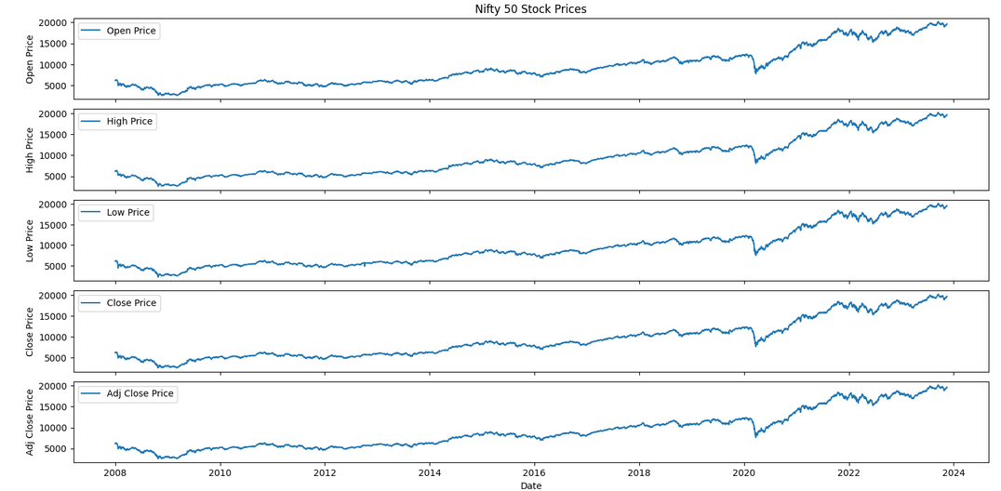
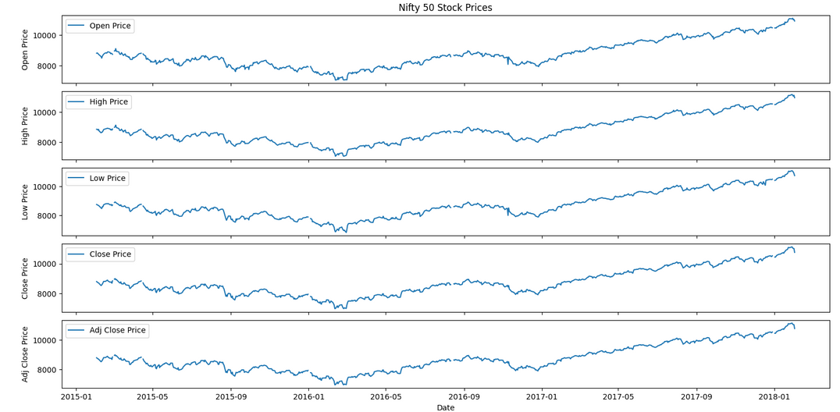
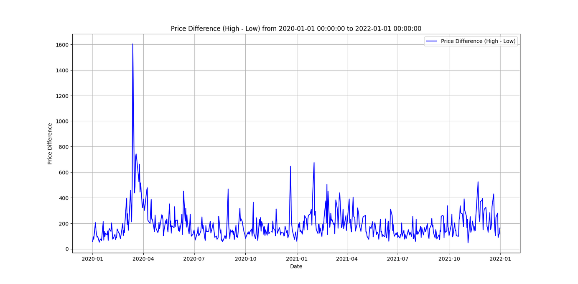
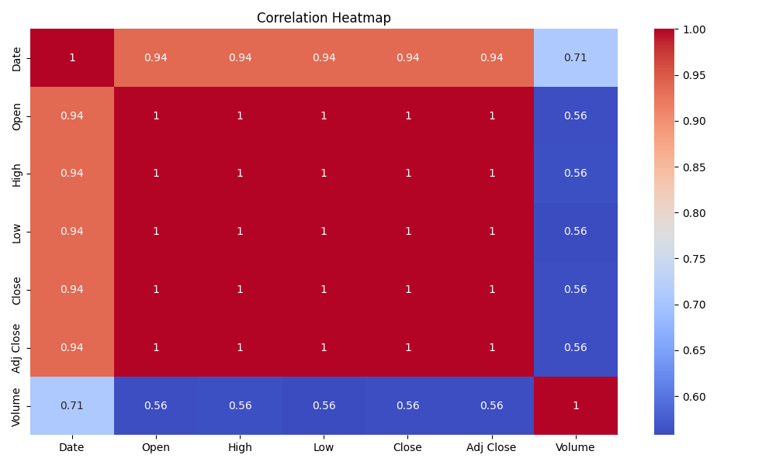
RESULTS

Slide 7
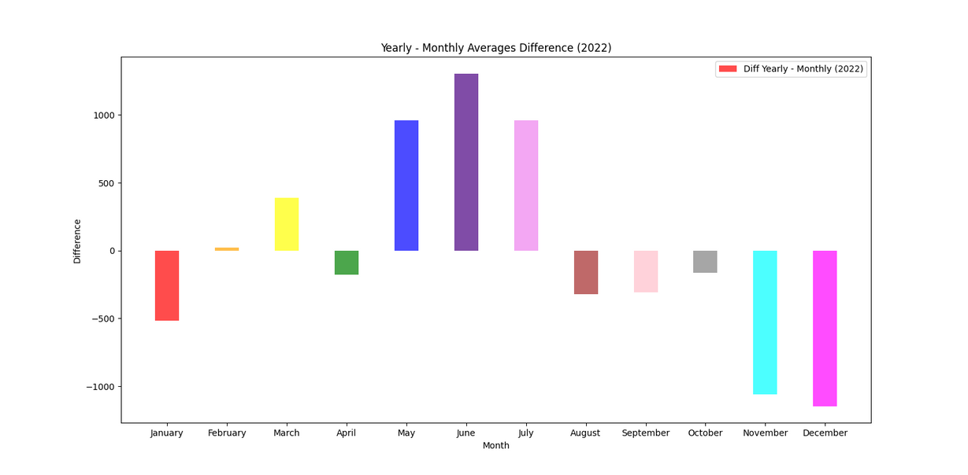
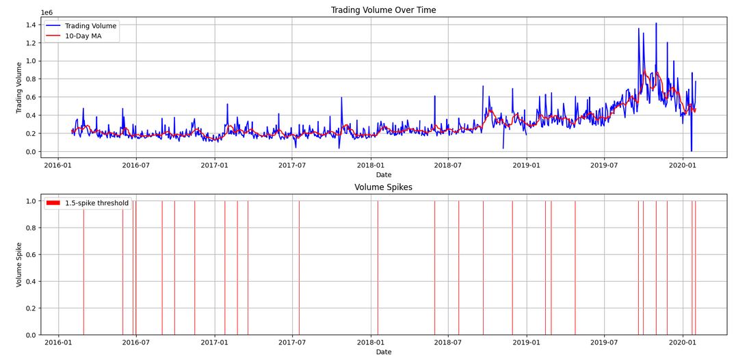
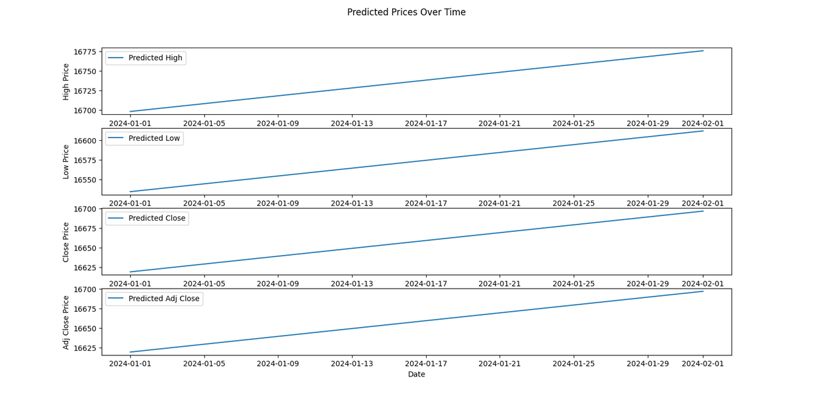
RESULTS

Slide 8
1
2
3
4
5
DATA COLLECTION
DATA CLEANING AND PRE-PROCESSING
DATA INTEGRITY
TO CHOOSE BEST PREDICTION MODEL
Place order!
LIVE DEMONSTRATION AND CHALLENGES FACED
5-Step Ordering Process

Slide 9
OBSERVATION
Data Reliability and Quality:
The web scraping process retrieves historical stock data from Yahoo Finance. The accuracy and reliability of predictions heavily rely on the quality and consistency of this data. Any discrepancies or errors in the source data may impact the predictive model's effectiveness.
Linear Regression Assumption:
The prediction model relies on a linear regression approach, assuming a linear relationship between time and stock prices. While this is a common and straightforward method, it may not capture complex market dynamics, especially during periods of high volatility or significant events.
Handling Missing Data:
The code demonstrates an approach to handling missing values by filling them with the mean of existing values. However, this method might oversimplify the impact of missing data on predictions. Alternative strategies, such as more advanced imputation techniques, could be explored for better accuracy.
pythonic Code Practices:
The code employs Pythonic features such as list comprehensions, datetime manipulations, and Pandas operations. These contribute to code readability and efficiency.
Visualization Impact:
The visual representation of predicted stock prices over time provides a clear and intuitive way to interpret the model's output.

Slide 10
Conclusion:
In conclusion, the presented stock price prediction solution leverages web scraping, linear regression, and Pythonic coding practices to forecast future prices. The motivation behind this project is rooted in the need to make informed financial decisions based on historical stock data. The approach involves breaking down the problem into data retrieval, preprocessing, modeling, and visualization.
THANK YOU

